Slide 1
Deep Neural Networks and Where to Find Them
Lecture 2
Artem Korenev, Nikita Gryaznov

Slide 2
Recap

Slide 3












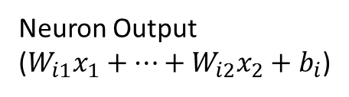
Recap
Dense Layer
$x_{1}$
Layer input
$x_{1}$
$$W$$
Neuron Output
($W_{i1}x_{1}+…+W_{i2}x_{2}+b_{i}$)
$$f$$
$$x_{2}$$
Activation function
(Non-linearity)
(Neuron activation)
$$f$$
$$x_{3}$$
$$f$$
$$x_{4}$$
Layer weight
(trainable parameter)
$$f$$
$$b$$
$$1$$
Layer bias
(trainable parameter)

Slide 4
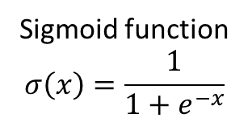








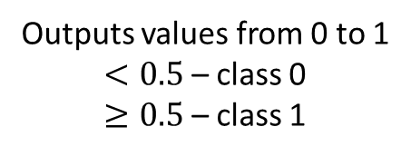


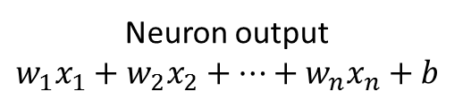

Binary Logistic Regression
Tumor Size
Neuron output
$$w_{1}x_{1}+w_{2}x_{2}+…+w_{n}x_{n}+b$$
Dense Layer
$x_{1}$
Age
$$w_{1}$$
Outputs values from 0 to 1
$<0.5$ – class 0
$≥0.5$ – class 1
$$x_{2}$$
$$w_{2}$$
$$w_{3}$$
$$x_{3}$$
$$σ$$
$$x_{4}$$
$$w_{4}$$
$$b$$
Sigmoid function
$$σ\left(x\right)=\frac{1}{1+e^{−x}}$$
$$1$$

Slide 5









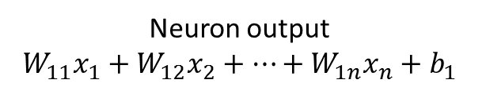

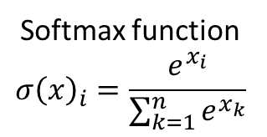
Multiclass Logistic Regression
Neuron output
$$W_{11}x_{1}+W_{12}x_{2}+…+W_{1n}x_{n}+b_{1}$$
Tumor Size
Dense Layer
$x_{1}$
$$W$$
Outputs values from 0 to 1
Decision made by
the biggest value in the output
Age
$$sm$$
$$x_{2}$$
$$x_{3}$$
$$sm$$
$$x_{4}$$
$$sm$$
$$b$$
Softmax function
$$σ{\left(x\right)}_{i}=\frac{e^{x_{i}}}{\sum_{k=1}^{n}{e^{x_{k}}}}$$
$$1$$

Slide 6
















2 Layer NN with one output
Dense Layer
Dense Layer
$x_{1}$
$$W_{1}$$
$$f$$
$$w_{21}$$
$$x_{2}$$
$$w_{22}$$
$$x_{3}$$
$$f$$
$$f$$
$$w_{23}$$
$$x_{4}$$
$$f$$
$$b_{2}$$
$$b_{1}$$
$$1$$
$$1$$

Slide 7





















3 Layer NN with two outputs
Dense Layer
Dense Layer
Dense Layer
$x_{1}$
$$W_{1}$$
$$W_{2}$$
$$f$$
$$f$$
$$W_{3}$$
$$x_{2}$$
$$f$$
$$x_{3}$$
$$f$$
$$f$$
$$f$$
$$x_{4}$$
$$f$$
$$f$$
$$b_{1}$$
$$b_{2}$$
$$b_{3}$$
$$1$$
$$1$$
$$1$$

Slide 8
Logistic Regression Optimization
Neuron output
$$w_{1}x_{1}+w_{2}x_{2}+…+w_{n}x_{n}+b$$
Dense Layer
$x_{1}$
Loss Function Value
$$w_{1}$$
$$x_{2}$$
$$w_{2}$$
$$w_{3}$$
Loss Function
$$x_{3}$$
$$σ$$
$$x_{4}$$
$$w_{4}$$
$$b$$
Sigmoid function
$$σ\left(x\right)=\frac{1}{1+e^{−x}}$$
$$1$$

Slide 9
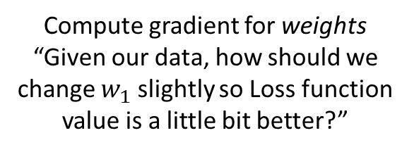
Logistic Regression Optimization
Compute gradient for weights
“Given our data, how should we change $w_{1}$ slightly so Loss function value is a little bit better?”
Neuron output
$$w_{1}x_{1}+w_{2}x_{2}+…+w_{n}x_{n}+b$$
Dense Layer
$x_{1}$
Loss Function Value
$$w_{1}$$
$$x_{2}$$
$$w_{2}$$
$$w_{3}$$
Loss Function
$$x_{3}$$
$$σ$$
$$x_{4}$$
$$w_{4}$$
$$b$$
Sigmoid function
$$σ\left(x\right)=\frac{1}{1+e^{−x}}$$
$$1$$

Slide 10
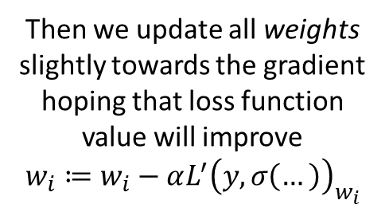
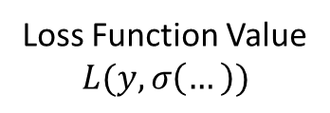
Logistic Regression Optimization
Compute gradient for weights
“Given our data, how should we change $w_{1}$ slightly so Loss function value is a little bit better?”
Neuron output
$$w_{1}x_{1}+w_{2}x_{2}+…+w_{n}x_{n}+b$$
Dense Layer
$x_{1}$
Loss Function Value
$$L(y, σ\left(…\right))$$
Then we update all weights
slightly towards the gradient hoping that loss function value will improve
$$w_{i}≔w_{i}−αL^{′}{\left(y,σ\left(…\right)\right)}_{w_{i}}$$
$$w_{1}$$
$$x_{2}$$
$$w_{2}$$
$$w_{3}$$
Loss Function
$$x_{3}$$
$$σ$$
$$x_{4}$$
$$w_{4}$$
$$b$$
Sigmoid function
$$σ\left(x\right)=\frac{1}{1+e^{−x}}$$
$$1$$

Slide 11
Logistic Regression Optimization
Compute gradient for weights
“Given our data, how should we change $w_{1}$ slightly so Loss function value is a little bit better?”
Neuron output
$$w_{1}x_{1}+w_{2}x_{2}+…+w_{n}x_{n}+b$$
Dense Layer
$x_{1}$
Loss Function Value
$$L(y, σ\left(…\right))$$
Then we update all weights
slightly towards the gradient hoping that loss function value will improve
$$w_{i}≔w_{i}−αL^{′}{\left(y,σ\left(…\right)\right)}_{w_{i}}$$
$$w_{1}$$
$$x_{2}$$
$$w_{2}$$
$$w_{3}$$
Loss Function
$$x_{3}$$
$$σ$$
$$x_{4}$$
$$w_{4}$$
Repeat calculating loss, computing gradients and updating the weights
(gradient descent)
$$b$$
Sigmoid function
$$σ\left(x\right)=\frac{1}{1+e^{−x}}$$
$$1$$

Slide 12
NN Optimization. Chain Rule

Slide 13

Optimizing Complex Networks
Dense Layer
Dense Layer
Dense Layer
$x_{1}$
$$W_{1}$$
$$W_{2}$$
$$f$$
$$f$$
$$W_{3}$$
$$x_{2}$$
$$f$$
$$x_{3}$$
$$f$$
$$f$$
$$f$$
$$x_{4}$$
How do we compute gradients for this weight?
$$f$$
$$f$$
$$b_{1}$$
$$b_{2}$$
$$b_{3}$$
$$1$$
$$1$$
$$1$$

Slide 14
How to update weights?
We need to compute gradients for deeper layers
We can do it viewing our neural network as a computational graph and using the chain rule
Computing gradients and optimizing the neural network called backpropagation

Slide 15

Chain rule
$$L=f\left(g\left(x\right)\right)$$
$$\frac{dL}{dx}=\frac{df}{dg}\frac{dg}{dx}$$
$$L=log⁡(x^{2})$$
$$f\left(x\right)=\log\left(x\right) g\left(x\right)=x^{2}$$
$$\frac{dL}{dx}=\frac{1}{x^{2}}×2x=\frac{2}{x}$$

Slide 16
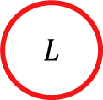
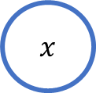

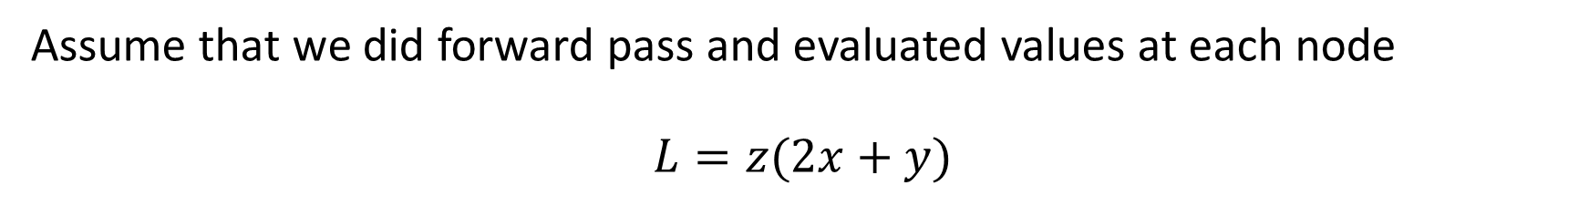



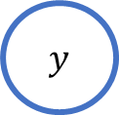

Chain rule
Assume that we did forward pass and evaluated values at each node
$$L=z(2x+y)$$
$$x$$
$$×$$
$$+$$
$$2$$
$$y$$
$$×$$
$$L$$
$$z$$

Slide 17


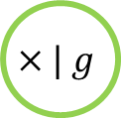
Chain rule
$$g(x)=2x$$
$$f(g,y)=g+y$$
$$L(z,f)=zf$$
$$x$$
$$×| g$$
$$+ | f$$
$$2$$
$$y$$
$$×$$
$$L$$
$$z$$

Slide 18
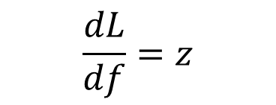
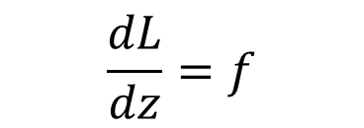
Chain rule
$$g(x)=2x$$
$$f(g,y)=g+y$$
$$L(z,f)=zf$$
$$x$$
$$\frac{dL}{df}=z$$
$$×| g$$
$$+ | f$$
$$2$$
$$y$$
$$×$$
$$L$$
$$z$$
$$\frac{dL}{dz}=f$$

Slide 19
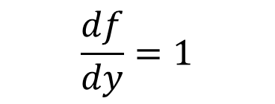

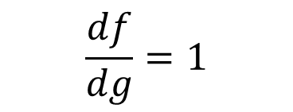

Chain rule
$$g=2x$$
$$f=g+y$$
$$L=zf$$
$$x$$
$$\frac{df}{dg}=1$$
$$\frac{dL}{df}=z$$
$$×| g$$
$$+ | f$$
$$2$$
$$y$$
$$×$$
$$L$$
$$\frac{df}{dy}=1$$
$$z$$
$$\frac{dL}{dz}=f$$

Slide 20

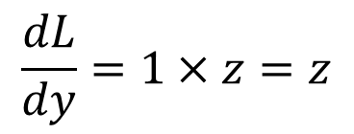
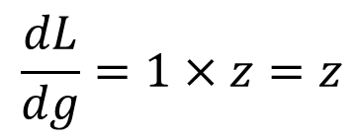

Chain rule
$$g=2x$$
$$f=g+y$$
$$L=zf$$
$$\frac{dL}{dg}=1×z=z$$
$$x$$
$$\frac{dL}{df}=z$$
$$×| g$$
$$+ | f$$
$$2$$
$$y$$
$+$
$$L$$
$$z$$
$$\frac{dL}{dy}=1×z=z$$
$$\frac{dL}{dz}=f$$

Slide 21

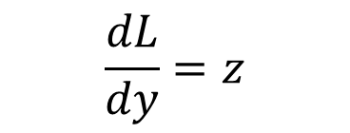
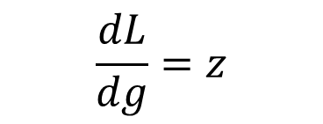
Chain rule
$$g=2x$$
$$f=g+y$$
$$L=zf$$
$$\frac{dg}{dx}=2$$
$$\frac{dL}{dg}=z$$
$$x$$
$$×| g$$
$$+ | f$$
$$2$$
$$y$$
$+$
$$L$$
$$z$$
$$\frac{dL}{dy}=z$$

Slide 22


Chain rule
$$g=2x$$
$$f=g+y$$
$$L=zf$$
$$\frac{dL}{dx}=2×z$$
$$\frac{dL}{dg}=z$$
$$x$$
$$×| g$$
$$+ | f$$
$$2$$
$$y$$
$+$
$$L$$
$$z$$
$$\frac{dL}{dy}=z$$

Slide 23
Backpropagation
At each step we only need to store gradient of the next layer and values of its inputs
$$x$$
$$×$$
$$+$$
$$2$$
$$y$$
$+$
$$L$$
$$z$$

Slide 24
Mini-batch
Evaluate,
Update
Train Data
One Epoch
Batch
Batch
Batch
Batch
Batch
Batch
Evaluate, Update
Evaluate, Update
Evaluate, Update
Evaluate, Update
Evaluate, Update
Evaluate, Update

Slide 25
NN Matrix Representation

Slide 26
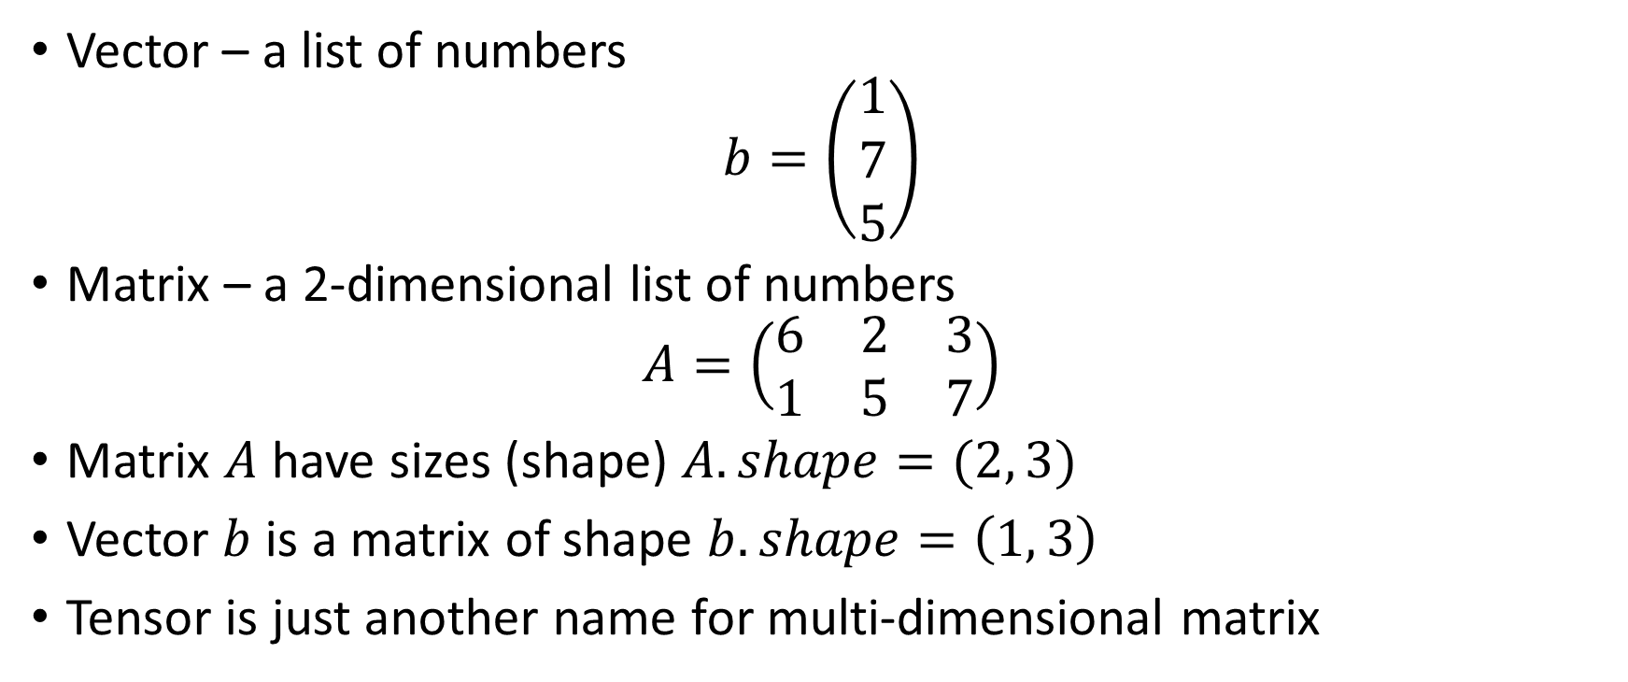
Linear Algebra Recap
Vector – a list of numbers
$$b=\left(\begin{matrix}1 \\ 7 \\ 5\end{matrix}\right)$$
Matrix – a 2-dimensional list of numbers
$$A=\left(\begin{matrix}6 & 2 & 3 \\ 1 & 5 & 7\end{matrix}\right)$$
Matrix $A$ have sizes (shape) $A.shape=(2, 3)$
Vector $b$ is a matrix of shape $b.shape=\left(1, 3\right)$
Tensor is just another name for multi-dimensional matrix

Slide 27
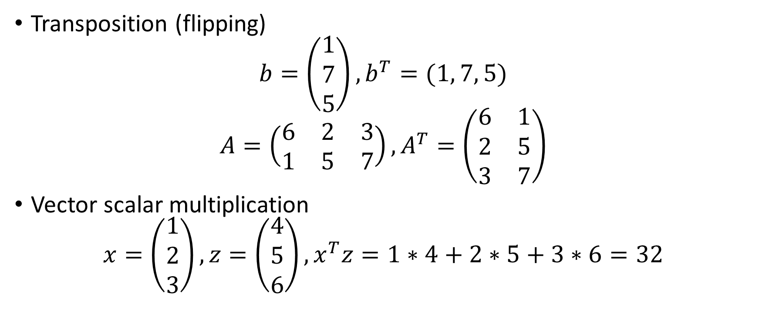
Vector and Matrix Operations
Transposition (flipping)
$$b=\left(\begin{matrix}1 \\ 7 \\ 5\end{matrix}\right),b^{T}=(1, 7, 5)$$
$$A=\left(\begin{matrix}6 & 2 & 3 \\ 1 & 5 & 7\end{matrix}\right), A^{T}=\left(\begin{matrix}6 & 1 \\ 2 & 5 \\ 3 & 7\end{matrix}\right)$$
Vector scalar multiplication
$$x=\left(\begin{matrix}1 \\ 2 \\ 3\end{matrix}\right),z=\left(\begin{matrix}4 \\ 5 \\ 6\end{matrix}\right), x^{T}z=1∗4+2∗5+3∗6=32$$

Slide 28
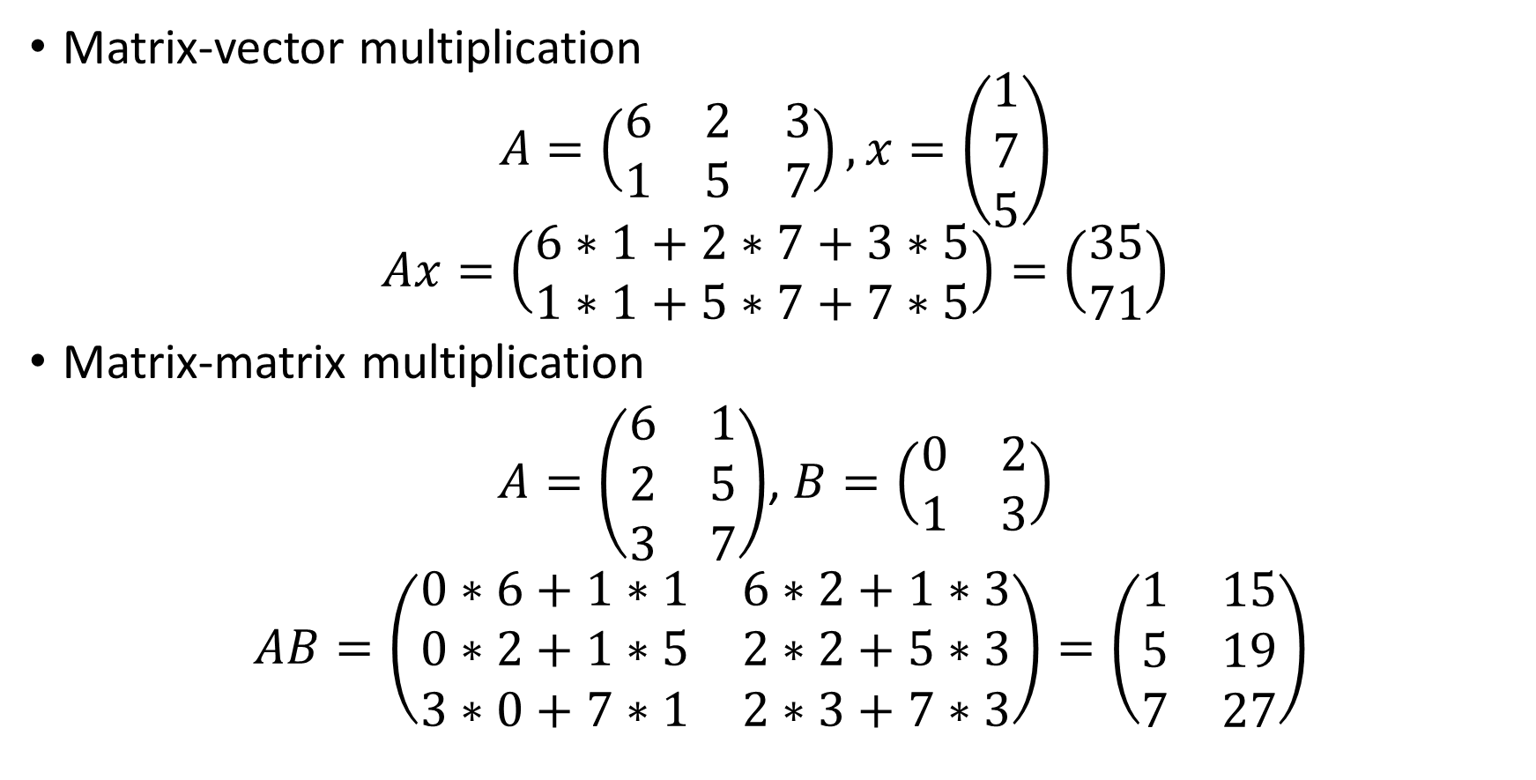
Vector and Matrix Operations
Matrix-vector multiplication
$$A=\left(\begin{matrix}6 & 2 & 3 \\ 1 & 5 & 7\end{matrix}\right),x=\left(\begin{matrix}1 \\ 7 \\ 5\end{matrix}\right)$$
$$Ax=\left(\begin{matrix}6∗1+2∗7+3∗5 \\ 1∗1+5∗7+7∗5\end{matrix}\right)=\left(\begin{matrix}35 \\ 71\end{matrix}\right)$$
Matrix-matrix multiplication
$A=\left(\begin{matrix}6 & 1 \\ 2 & 5 \\ 3 & 7\end{matrix}\right)$, $B=\left(\begin{matrix}0 & 2 \\ 1 & 3\end{matrix}\right)$
$AB=\left(\begin{matrix}0∗6+1∗1 & 6∗2+1∗3 \\ 0∗2+1∗5 & 2∗2+5∗3 \\ 3∗0+7∗1 & 2∗3+7∗3\end{matrix}\right)=\left(\begin{matrix}1 & 15 \\ 5 & 19 \\ 7 & 27\end{matrix}\right)$

Slide 29
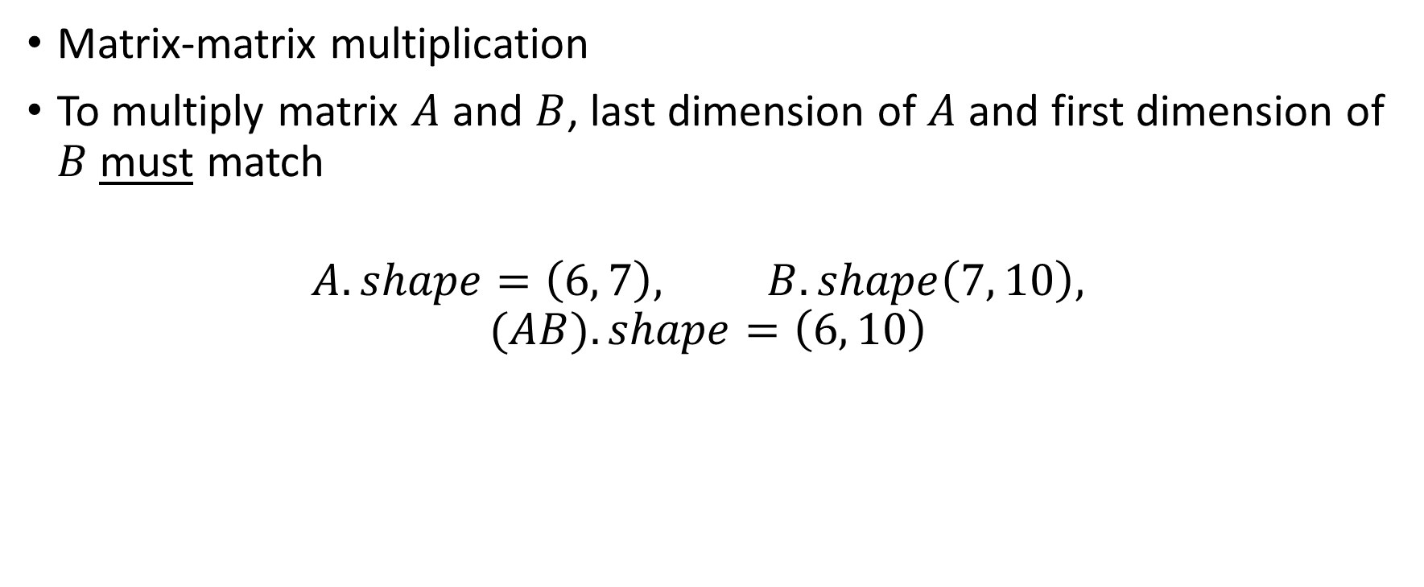
Vector and Matrix Operations
Matrix-matrix multiplication
To multiply matrix $A$ and $B$, last dimension of $A$ and first dimension of $B$ must match
$$A.shape=\left(6, 7\right), B.shape\left(7, 10\right),$$
$$(AB).shape=\left(6, 10\right)$$

Slide 30

Input as a Matrix
Our NN has input of size $N$ (tumor size, age, …)
We pass $B$ (batch size) data points at once
We can represent our input batch as a matrix of shape $(B,N)$
Let’s think of Dense layer matrix representation

Slide 31










Dense Layer via Matrices
Dense Layer
$x_{1}$
$$W$$
$$f$$
$$x_{2}$$
$$x_{3}$$
$$f$$
4 inputs
$$x_{4}$$
3 outputs
$$f$$
$$b$$
$$1$$

Slide 32
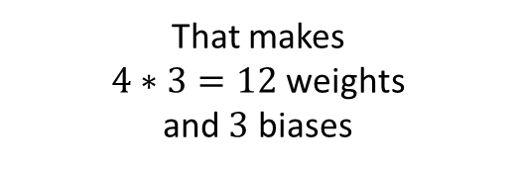
Dense Layer via Matrices
Dense Layer
$x_{1}$
$$W$$
$$f$$
$$x_{2}$$
$$x_{3}$$
$$f$$
4 inputs
$$x_{4}$$
3 outputs
$$f$$
$$b$$
That makes
$4∗3=12$ weights
and $3$ biases
$$1$$

Slide 33
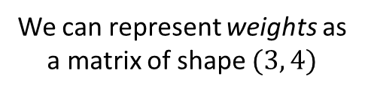
Dense Layer via Matrices
Dense Layer
We can represent weights as a matrix of shape $(3, 4)$
$x_{1}$
$$W$$
$$f$$
$$x_{2}$$
$$x_{3}$$
$$f$$
4 inputs
$$x_{4}$$
3 outputs
$$f$$
$$b$$
That makes
$4∗3=12$ weights
and $3$ biases
$$1$$

Slide 34
Dense Layer via Matrices
Dense Layer
We can represent weights as a matrix of shape $(3, 4)$
$x_{1}$
$$W$$
$$f$$
$$x_{2}$$
$$x_{3}$$
$$f$$
4 inputs
$$x_{4}$$
3 outputs
$$f$$
$$b$$
That makes
$4∗3=12$ weights
and $3$ biases
$$1$$
We can represent biases
as a vector of shape (3, 1)

Slide 35
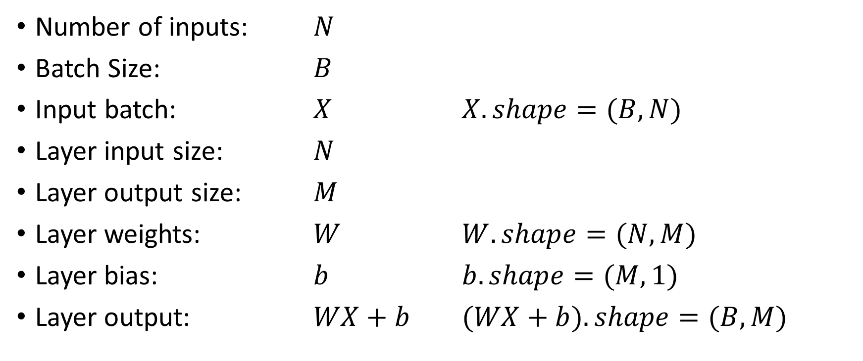
Dense Layer via Matrices
Number of inputs: $N$
Batch Size: $B$
Input batch: $X$ $X.shape=(B,N)$
Layer input size: $N$
Layer output size: $M$
Layer weights: $W$ $W.shape=(N,M)$
Layer bias: $b$ $b.shape=(M,1)$
Layer output: $WX+b$ $(WX+b).shape=(B,M)$

Slide 36
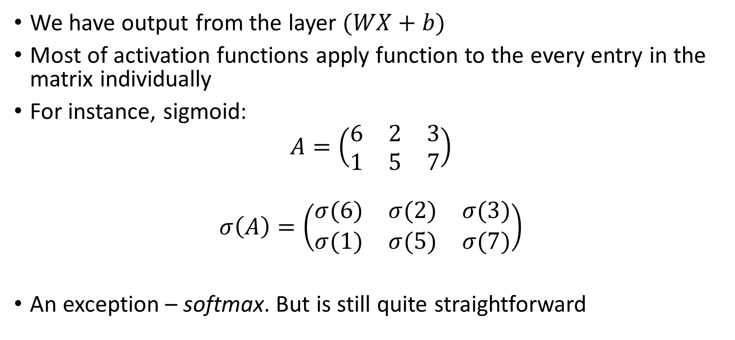
Applying Activation Functions
We have output from the layer $(WX+b)$
Most of activation functions apply function to the every entry in the matrix individually
For instance, sigmoid:
$$A=\left(\begin{matrix}6 & 2 & 3 \\ 1 & 5 & 7\end{matrix}\right)$$
$$σ\left(A\right)=\left(\begin{matrix}σ(6) & σ(2) & σ(3) \\ σ(1) & σ(5) & σ(7)\end{matrix}\right)$$
An exception – softmax. But is still quite straightforward

Slide 37
Why Do We Care About These Matrices
It is faster
People wrote a lot of code for efficient matrix operations
Graphical Processing Units can process this even more efficiently

Slide 38
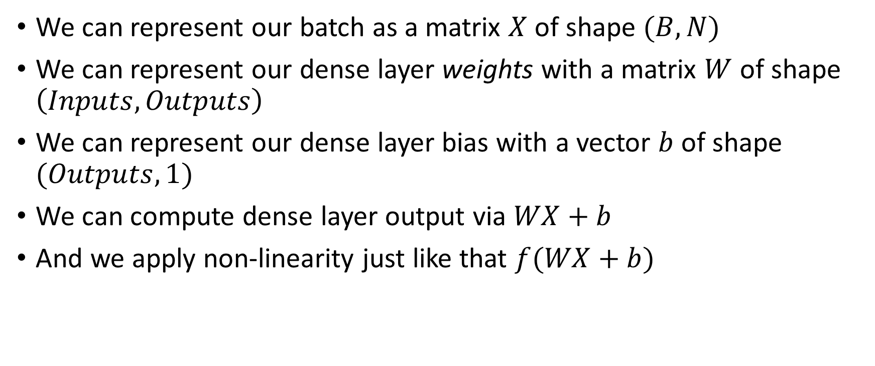
Matrices Recap
We can represent our batch as a matrix $X$ of shape $(B,N)$
We can represent our dense layer weights with a matrix $W$ of shape $\left(Inputs, Outputs\right)$
We can represent our dense layer bias with a vector $b$ of shape $(Outputs, 1)$
We can compute dense layer output via $WX+b$
And we apply non-linearity just like that $f(WX+b)$

Slide 39
Lecture Recap
Logistic regression is a 1-layer Neural Network
We optimize it with gradient descent
To compute gradients for deeper models we use backpropagation
We also train models in a mini-batch setting
We can represent our neural networks via matrix multiplications

Slide 40
This is It For the Second Lecture

